Slide 1
Catching FHIR Igniting the Value of Health Data
Lloyd McKenzie
August 15, 2013

Slide 2
Objectives
Be able to explain
What FHIR is
Why you should care
How does FHIR relate to other HL7 standards
Realistic timeframes for FHIR adoption
Possible FHIR transition strategies
Answer all (or at least many) of your FHIR-related questions

Slide 3
Healthcare Standards
Complex…. Slow…
Hard to use and understand
Require specialist skills, tools
Costly
What if it didn’t have to be like that?

Slide 4
Introducing FHIR
Fast Health Interoperability Resources
Pronounced “Fire”
Based on industry best practices, with a focus on simplicity and implementability
Leverage web technologies
Human readability as base level of interoperability
One syntax – documents, messages, services, REST
Computable templates/profiles that work in all architectures

Slide 5


Resources
“Resources” are:
Small logically discrete units of exchange
Defined behaviour and meaning
Known identity / location
Smallest unit of transaction
“of interest” to healthcare
E.g. Patient, Provider, Specimen, Drug, Lab Result, Allergy, Care Plan, Study, Adverse Reaction

Slide 6
Resources have 3 parts
Defined Structured Data
The logical, common contents of the resource
Mapped to formal definitions/RIM & other formats
Extensions
Local requirements, but everyone can use
Published and managed (w/ formal definitions)
Narrative
Human readable (fall back)

Slide 7
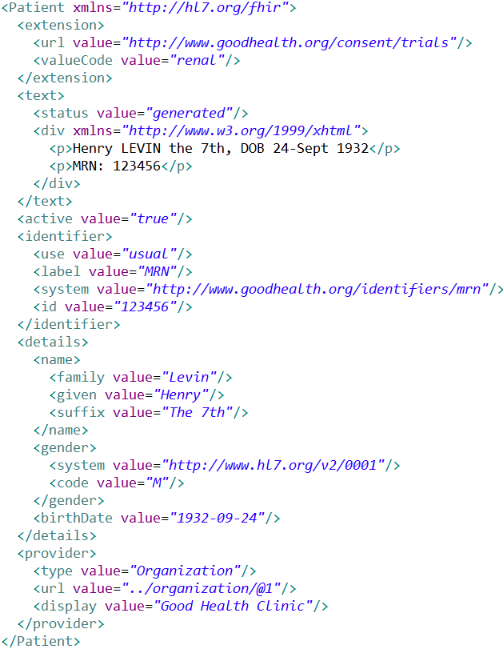
Extension with reference to its definition
Human Readable Summary
Standard Data Content:
MRN
Name
Gender
Date of Birth
Provider

Slide 8
Extensions
Managing extensibility is a central problem
Everyone needs extensions, everyone hates them
Alternative is too complex
FHIR tames extensibility
Built in extensibility framework (engineering level)
Define, publish, find extensions
Use them
This tames the overall specification

Slide 9
Is it better?
Comparing FHIR and prior HL7 standards

Slide 10
V2 and FHIR
Similarities
FHIR Differences
Built around re-usable “chunks” of data
Strong forward/backward compatibility rules
Extensibility mechanism
Each chunk (resource) is independently addressable
More than messages
Human readable required
Extensions don’t collide, are discoverable
Modern tools/skills
Instances easy to read
Lighter spec

Slide 11
V3 and FHIR
Similarities
FHIR Differences
Based on RIM, vocab & ISO Data types foundations
Support XML syntax
Simpler models & syntax (reference model hidden)
Friendly names
Extensibility with discovery
Easy inter-version wire compatibility
Messages, documents, etc. use same syntax
JSON syntax too
Notes:
Lower learning curve

Slide 12
V3 and CDA
Similarities
FHIR Differences
Support profiling for specific use-cases
Human readability is minimum for interoperability
APIs, validation tooling, profile tooling
(See v3 similarities on prior slide)
Can use out of the box – no templates required
Not restricted to just documents
Implementer tooling generated with spec
(See v3 differences on prior slide)

Slide 13
FHIR and Services
Similarities
FHIR differences
Encourage context neutral, re-usable structures with defined behavior
RESTful interface is a simple SOA interface
Consistent data structures across services
Ease of transport across paradigms message <-> service <-> document <-> REST
Standard framework for defining/discovering services
Notes:
FHIR allows defining additional services via the “query” mechanism as well as custom services.

Slide 14
So why use anything else?
FHIR is brand new
No market share
Not yet passed ballot
Little track record
Business case
No-one dumps existing working systems just because something new is “better”
Large projects committed to one standard won’t change direction quickly (or even at all)

Slide 15
Simple message
Yes, FHIR has the potential to supplant HL7 v3, CDA and even v2
However
It’s not going to do so any time soon
No one's going to throw away their investment in older standards to use FHIR until
The specification has a good track record
It’s clear the new thing provides significant benefits
HL7 will support existing product lines so long as the market needs them
Notes:
12:05

Slide 16
Timelines & Readiness

Slide 17
Current state
3 completed connectathons (25+ implementers)
4th coming up in 37 days
IHE & DICOM both exploring
W3C assisting with Semantic Web aspects
1st DSTU ballot open now with full support for content in CCDA, but much still to be done
DSTU published ~Jan. 2014

Slide 18
Implementer supports
Multiple reference implementations
Auto-generated interfaces in 4+ languages
Public test servers
Automated test tools
Draft tooling to convert CCDA -> FHIR
Tooling in progress for Profile development/maintenance

Slide 19
Looking forward
Over next 2-3 years
Additional DSTUs updating existing content, adding new resources & profiles
Some projects, external SDOs & new national initiatives start referencing FHIR
After 2-3 years
Begin making FHIR and some resources Normative
Migration begins if/when a financial business case can be made

Slide 20
If you want to get ready
FHIR will show up in different places in different timeframes
Some IHE profiles and national program specs next year
Your internal hospital interface, maybe never
Regardless of timeframe, you can look at ways to prepare for FHIR now
Notes:
Even if Meaningful Use sticks with CDA for another 10 years, and your hospital sticks with v2 for another 20, that doesn’t mean you can’t use FHIR

Slide 21
Positioning for FHIR

Slide 22
Getting ready
Get familiar with FHIR
Consider FHIR for new requirements
Social web & mobile (PHR, workflow)
E.g. Expose appointments or lab data to patient’s on their smart phones
Map existing internal interfaces to FHIR to allow easy external interfacing
Look at adopting FHIR as an internal architecture
Notes:
Spec shouldn’t take more than a weekend to read and thoroughly understand. Basic grasp within a day

Slide 23
Migration – v2
Already have an integration engine that supports translation between v2 and FHIR
Resources map to segments reasonably well
As always, the challenge with v2 mapping is the variability of v2 interfaces
“Common” mappings can be created, but they won’t be one size fits all
HL7 v2

Slide 24
Migration – v3
V3 migrations should be more straight-forward as semantics are clear
Migrations will tend to be based on templates and realm constraints rather than international specs
Round-trip transforms are possible
Which get targeted first will depend on implementer desires
HL7 v3

Slide 25

Migration – CDA
Made more complex by human-readable nature
Need to ensure text <-> entry linkages are retained
Will best be handled on a template by template basis
Likely start with important ones like C-CDA
Notes:
12:15
Text linkages not as important when not human-attested

Slide 26
Early use of FHIR
IHE has indicated an intention to profile FHIR for the next version of their Mobile access to Health Documents (MHD) spec
Essentially a RESTful equivalent to XDS
Expected Winter/Spring 2014
They’re also exploring profiling the SecurityEvent to provide an HTTP equivalent to ATNA with extra reporting and alerting functions

Slide 27
Follow Up
Read the spec: hl7.org/fhir
Follow #FHIR on Twitter
Shape the specification:
Participate in the Ballot
Try implementing it
Come to the next Connectathon
Come to the Sept. HL7 WGM (Cambridge)
Contact me
lloyd@lmckenzie.com

